Slide 1
Object Oriented Programming in JAVA

Slide 2
Object Oriented Programming
Objective: Introduction to Object Oriented Programming, to become familiar with Objects and classes, declaring a class with instance variables and methods and Instantiating an object of a class, and become familiar with:
instance variables and methods
access modifiers : private, public and protected
Accessors and Mutators getters() and setters() .
Constructor and Destructor.
Static (class) variables

Slide 3
Object Oriented Programming
What is a Programming Paradigm ?
Definition: A programming paradigm is a style or “way” of programming.
Some of the more common paradigms are:
Structured — Programs have clean, goto-free, nested control structures.
Array-based —
Functional Programming

Slide 4
Object Oriented Programming
Some of the more common paradigms are:
Event-Driven — Control flow is determined by asynchronous actions (from humans or sensors).
GUI-Based

Slide 5
Programming Paradigm
Imperative — Control flow is an explicit sequence of commands.
Procedural — Imperative programming with procedure calls.
Flow-Driven — Computation is specified by multiple processes communicating over predefined channels.
Logic (Rule-based) — Programmer specifies a set of facts and rules, and an engine infers the answers to questions.

Slide 6
Programming Paradigm
Constraint — Programmer specifies a set of constraints, and an engine infers the answers to questions.
Aspect-Oriented — Programs have cross-cutting concerns applied transparently
Object-Oriented — Computation is effected by sending messages to objects; objects have state and behavior.
Class-based — Objects get their state and behavior based on membership in a class.

Slide 7
Introduction to Object-Oriented Programming
Object-Oriented Programming : is a Programming paradigm or a software
development methodology in which a program is conceptualized as a group of objects .
A Programming technique in which a program is organized as a collection of objects.
A software development approach for writing and developing computer programs based on objects.

Slide 8
Introduction to Object-Oriented Programming
OOP provides an easy of modeling things in the real world.
OOP organizes & combines data and functions together, hides and encapsulates the implementation details and offers several features for developing computer softwares.

Slide 9
Object-oriented programming is the most dramatic innovation in software development.
Integrating data and functions (methods) is the central idea of object-oriented programming.
Using object-oriented programming we can write clearer, more reliable, more easily maintained programs.
The class is the foundation of Java’s support for object-oriented programming.

Slide 10
Object-oriented programming aims to achieve the following:
To simplify the design and implementation of complex programs.
To make it easier for teams of designers and programmers to work on a single software project.
To enable a high degree of reusability of designs and of software codes.
To decrease the cost of software maintenance.

Slide 11
OOP : makes the development process easier faster and less time consuming.
OOP features :
Classes and Objects
Data Abstraction & Encapsulation
Inheritance and Code-reusability
Polymorphism
Interfaces
And a programming language that supports or follows these features is called an Object-Oriented Programming Language.
Java is a an OOP language.

Slide 12
Apart from these concepts, there are some other terms which are used in Object-Oriented programming:
Coupling
Cohesion
Association
Aggregation
Composition

Slide 13
Program Modules in in java
Three kinds of modules exits in java- methods, classes and packages.
Java Programs are written with predefined methods and classes available in the Java Application Programming Interfaces (also referred to as the Java API or Java class library).
Related classes are grouped into packages so that they can be imported into programs and reused.
The Java API classes are part of the JDK.

Slide 14
OOP Classes and Objects
Two key concepts in OOP are :
Classes and Objects
A class consists of both member data (variables) and member functions (methods).
class is a blueprint or template for creating objects. It defines the attributes (data members) and behaviors (methods) that its objects will have.
A class is a user-defined data type that encapsulates data and functions into a single unit, promoting modularity and reusability.
A class is a logical construct that groups related variables (attributes) and functions (methods) under a common name, enforcing encapsulation.

Slide 15
OOP Classes and Objects
A class is an abstraction that represents real-world entities in software development, defining properties and behaviors but without actual memory allocation until instantiated.
A class serves as a foundation for object creation, allowing multiple instances to be created with shared structure but independent data.

Slide 16
OOP Classes and Objects
The class is the foundation of Java’s support for object-oriented programming.
The class provides the mechanism by which objects are created. Thus a class defines a new data type, which can be used to create objects.
A class is created by using the keyword class.
Collection of objects is called class.
A class can also be defined as a blueprint from which you can create an individual object.
Class doesn't consume any space.

Slide 17
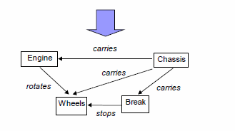
An Analogy
Classes : A class is a template for an object. Or
Classes are the definitions (or blueprints) Used to create objects.
U you can use definitions of class to create objects.
The structure or Design of a car

Slide 18
OOP Class and Object
Class: A class is a template for an object. OR
Classes are the definitions (or blueprints) Used to created objects.
Object : in general an object is an entity that has certain attributes or properties which may be assigned values The values can be numeric or non-numeric.
In OOP an Object is an instance of a class OR
an Object is a working copy of a class OR Look like a class.
Objects in a program can represent real world things e.g. automobiles, Mobiles, Books houses and employees.

Slide 19
OOP Class and Object
Syntax
class classname {
type instance-variable1;
type instance-variable2;
type instance-variableN;
type methodname1(parameter-list) {
// body of method
}
// ...
type methodnameN(parameter-list) {
// body of method
}
}

Slide 20
class student {
String roll_no;
}
class stduentTest {
public static viod main(String args[]){
student stdobj=new student();
stdobj.roll_no =“17sw02”;
} }

Slide 21
What is Java Application
Recall that main is a special method that is always called automatically by the JVM when you execute an application.
A class that contains method main is a java application.
class student is not an application because it does not contain main.
Error
Exception in thread main java.lang.NoSuchMethodError: main

Slide 22
Declaring a class with a method and Instantiating an object of a class.
A Simple Class
class Students {
public void DispayMsg()
{
System.out.println(“Welcome to Class SW-Section-I”);
} // end method
} // end class
Use Students Class
class StudentsTest {
public static void main (String args []) {
// Creating an object and asdign it to objStd
Students objStd=new Students();
{
// calling objStd’s method DisplayMsg()
objStd.DisplayMsg();
} // end main method
} // end class

Slide 23
Declaring a method with a parameter
A Simple Class
class Students {
public void dispalyName(String stdName)
{
System.out.println(stdName+“Welcome to Class SW-Section-I”);
} // end method
} // end class
Use Students Class
class StudentsTest {
public static void main (String args []) {
// Creating an object and asdign it to objStd
Students objStd=new Students();
{
// calling objStd’s method DisplayMsg()
objStd.displatname(“Ali");
} // end main method
} // end class

Slide 24
OOP Classes and Objects
Two key concepts in OOP are :
Classes and Objects
Object An object is and entity that has certain attributes or properties sometimes called characteristics which may be assigned values The values can be numeric or non-numeric.
In OOP an Object is said to be an instance of a class or working copy of a class or Look like a class.
Objects in a program can represent real world things or abstractions e.g. automobiles, Mobiles, Books houses and employees.
An Object can be defined as an instance of a class. An object contains an address and takes up some space in memory.

Slide 25
An object is an instance of a class, containing actual values for the attributes defined in the class blueprint.
An object is a real-world entity representation in programming, having identity, state (data), and behavior (methods).
An object is a runtime entity created from a class, storing its own attribute values while sharing the class’s behavior.
An object is an encapsulated unit of data and functions, enabling interaction with other objects in an OOP system.
An object is an implementation of abstraction, where the defined class structure is transformed into a tangible entity with assigned memory.

Slide 26
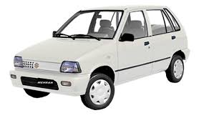
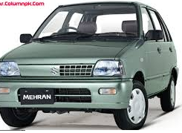
An Analogy
Object 1
Object 2

Slide 27

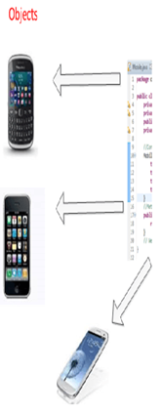
Introduction to Object-Oriented Programming
An Analogy
Examples of real world Objects
In the real world everywhere we look we see objects such :

Slide 28
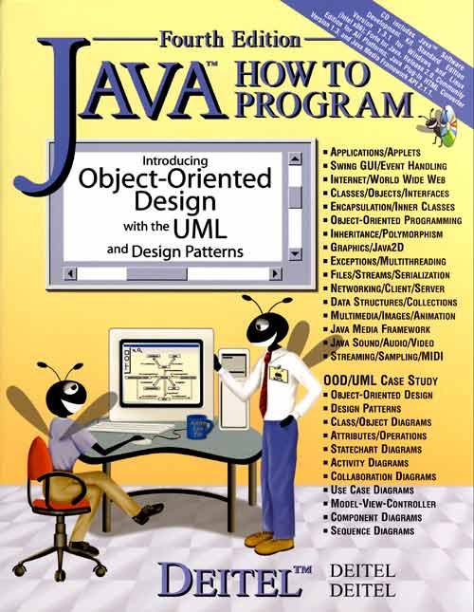

Introduction to Object-Oriented Programming
An object represents a real world entity
Following figure shows some real-world entities
Students
Object
Book object

Slide 29
Introduction to Object-Oriented Programming
Book object
Attributes/Properties
BookName
AuthorName
Price
Edition

Slide 30
Introduction to Object-Oriented Programming
car object
Attributes
Name
Model
Price
Color

Slide 31
Introduction to Object-Oriented Programming
Students
Attributes
Object
Name
RollNo
Address

Slide 32
Introduction to Object-Oriented Programming
Attributes with values
car object
Name=Alto
Model=2017
Price=
Color=white

Slide 33
Introduction to Object-Oriented Programming
Attributes with values
Students
Object
Name=Ali
RollNo=17Sw
Address=xyz

Slide 34
Introduction to Object-Oriented Programming
Attributes
Name
car object
Model
Behavior is equivalent to a method in a program
Price
Color
Behavior
Change gear()
Apply breaks()
Accelerate()

Slide 35
Introduction to Object-Oriented Programming
Attributes
Name
RollNo
Address
Behavior
setName()
changedept();
setdept();

Slide 36
Declaring a method with a parameter
A Simple Class
class Students {
Private String name;
public void dispalyName(String stdName)
{
System.out.println(stdName+“Welcome to Class SW-Section-I”);
} // end method
} // end class
In the example, encapsulation is demonstrated as an OOP concept in Java. Here, the variable “name” is kept private or “encapsulated.”
Use Students Class
class StudentsTest {
public static void main (String args []) {
// Creating an object and asdign it to objStd
Students objStd=new Students();
{
// calling objStd’s method DisplayMsg()
objStd.displatname(“Ali");
} // end main method
} // end class

Slide 37
Declaring a class with Instance Variables
A Simple Class
class Students {
String studentdame; // instance variable
public void setName(String stdName)
{
studentName=stdName;
} // end method
public String getName()
{
return studentName;
} // end method
} // end class
Use Students Class
class StudentsTest {
public static void main (String args []) {
// Creating an object and asdign it to objStd
Students objStd=new Students();
{
// calling objStd’s method DisplayMsg()
objStd.setName(“Ali");
System.out.println(“Welcome”+ objStd.getName());
} // end main method
} // end class

Slide 38
OOP Mutators & Accessors
Mutators (Set methods) &
Accessors (get methods)
These public methods are called set and get methods.
Allow the client of the class to set(i.e. assign values) to the private instance variables , and
get (i.e. obtain values) of private instance variables.

Slide 39
Controlling access to Members (Access Modifiers)
Access Specifiers : Define level of Accessibility of a variable or a method OR
The access modifiers control access to a class’s variables and methods.
Specify which part of the program can access a variable or a method.
Private : variables or methods declared with access specifier private are accessible only within a class in which they are declared.
It is the most restrictive access level.

Slide 40
Controlling access to Members (Access Modifiers)
Access Specifiers : Define level of Accessibility of a variable or a method OR
Public : variables or methods declared with access specifier public are accessible anywhere in the program (i.e. within a class in which they are declared and also within package, or even different packages outside that class )
Protected : variables or methods declared with access specifier protected are accessible within a class in which they are declared and also in the derived class).

Slide 41
Controlling access to Members (Access Modifiers)
Access Specifiers : Define level of Accessibility of a variable or a method OR
Default (No Modifier) Access Specifier
If no access specifier is specified, Java assigns default access.
It means the class, method, or variable is accessible only within the same package.

Slide 42
Introduction to Object-Oriented Programming
Data Encapsulation & Abstraction
Data Encapsulation: Is an OOP feature that binds together data and functions. OR
The wrapping of data and functions into a single unit. OR
Encapsulation in OOP is the practice of defining class attributes as private and providing controlled access through public methods, preventing unauthorized or unintended modifications to the object's state
The internal of the object is private to that object and may not be accessed from outside the object

Slide 43
Data Encapsulation is the process of bundling data (variables) and methods (functions) that operate on the data into a single unit, typically a class, while restricting direct access to some details.
Encapsulation is the technique of hiding internal implementation details of a class and exposing only necessary functionalities through controlled access mechanisms like getter and setter methods.
Encapsulation ensures that an object's data is hidden from direct external modification and can only be accessed or modified through well-defined interfaces, maintaining data integrity and security.
.

Slide 44
Introduction to Object-Oriented Programming
Abstraction: refers to the act of representing the functionality of a program and hide the internal details. OR
A feature of OOP where by the implementation details of class are kept hidden from the user.

Slide 45
Introduction to Object-Oriented Programming
The whole idea behind encapsulation is to hide the implementation details from users. If a data member is private it means it can only be accessed within the same class. No outside class.
How to implement encapsulation in java: 1) Make the instance variables private so that they cannot be accessed directly from outside the class. You can only set and get values of these variables through the methods of the class. 2) Have getter and setter methods in the class to set and get the values of the fields private data member (variable) of other class.

Slide 46
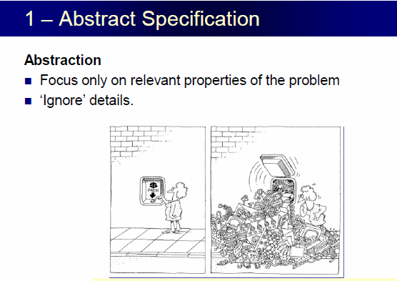
Data Encapsulation & Abstraction
Hiding internal details and showing functionality is known as abstraction. For example phone call, we don't know the internal processing.

Slide 47
Initializing Objects with Constructor
A Constructor is a special member function which is called/ executed automatically whenever an object of a class is created.
When an object of class is created, the constructor of that class is called.
It is used to Initialize an object, and to initialize the instance variables.
Automatic Initialization is carried out by a special member function called Constructor

Slide 48
.

Slide 49
Initializing Objects with Constructors
A constructor has two special characteristics that differentiate it from other class methods:
A constructor always has the same name as the class
A constructor never returns a value, and you must not specify a return type —not even of type void.
All classes have a default constructor which is parameter less.
If you don't define any constructors for your class, the compiler supplies a default constructor in the class, that initializes the instance variables to their default values (zero for numeric types, false for boolean, null for reference)

Slide 50
A Simple Class with Constructor
class Students {
String studentdame; // instance variable
//Constructor
// public Students () {
//studentdName=“anyName”) ;}
public void setName(String stdName)
{
studentName=stdName;
} // end method
public String getName()
{
return studentName;
} // end method
public void displayName()
{
System.out.println(getName());
} // end method
} // end class
Use Students Class
class StudentsTest {
public static void main (String args []) {
// Creating an object and assign it to objStd
Students objStd=new Students();
{
// calling objStd’s method displayName()
System.out.println(“Initial Value:”+ objStd.getName());
objStd.setName(“Ali");
System.out.println(“Welcome”+ objStd.getName());
} // end main method
} // end class

Slide 52
this Keyword
this refers to the current object‘s members. You can refers current object with this reference.
In Java, this is a reference variable that refers to the current object.
The compiler uses this implicitly when your method refers to an instance variable of the class.

Slide 53
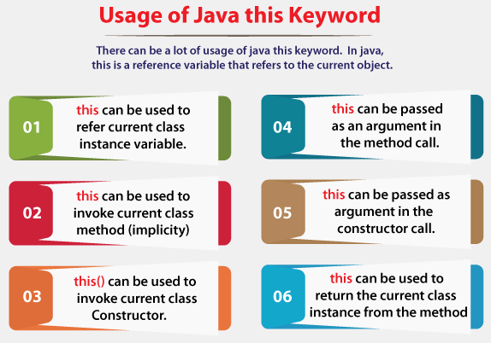
this Keyword

Slide 54
this Keyword
this refers to the current object‘s members. You can refers current object with this reference.
The compiler uses this implicitly when your method refers to an instance variable of the class.
Usage of java this keyword . 6 usage of java this keyword.
this can be passed as an argument in the method call.
this can be used to return the current class instance from the method.
this can be passed as argument in the constructor call.

Slide 55
Primitive Types vs. Reference Types
Data types in java are divided into two categories
Primitive Types and
Reference Types
Primitive Types are byte, int, char, Boolean, short, long, float and double.
A primitive variable can store exactly one value of its declared type at a time.

Slide 56
Reference Types
All non primitive types are references types, so classes, we specify the types of objects are reference types.
Variables of reference types (normally called references) store the locations of objects in the computer’s memory. Such variables are said to refer to objects in the program.

Slide 57
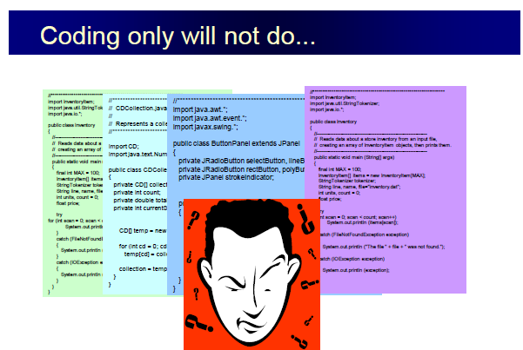
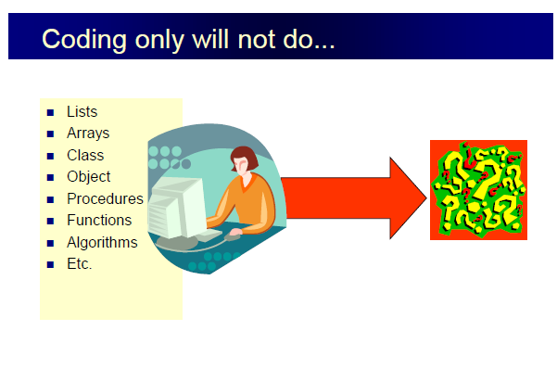

Slide 58
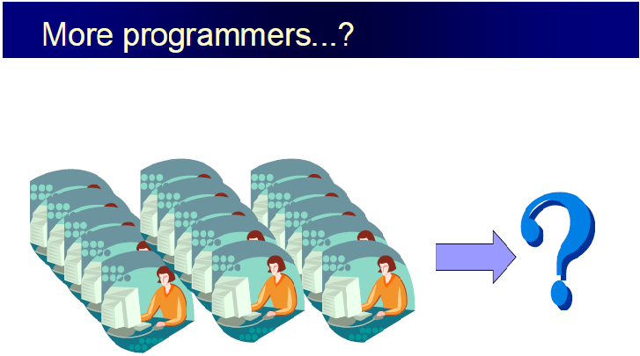

Slide 59
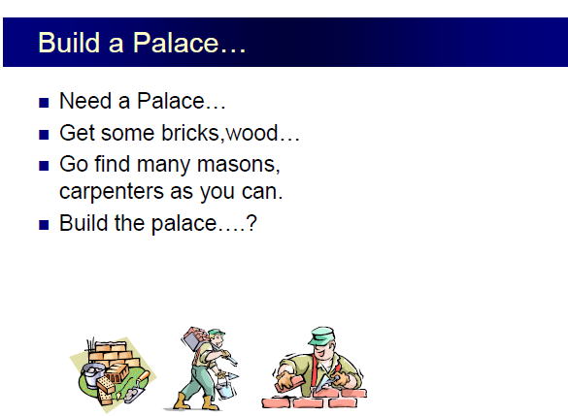


Slide 60
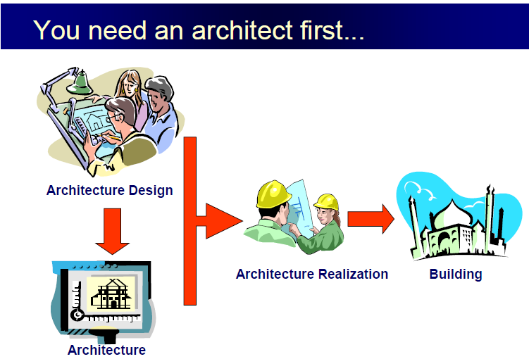


Slide 61
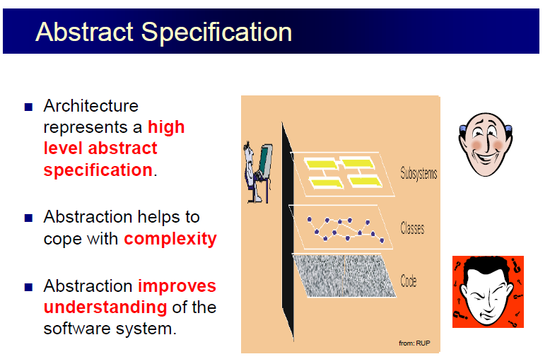
Coding is flat only in trivial systems.

Slide 62
University
BM
CS
SW
………..
Examination
Admission
Finance
Employees
Students

Slide 63
Class Tea {
float milk;
float water ;
float sugar;
float teadust;
public void maketea(milk, water, sugar, teadust)
{
// Code goes here
}
T

